Slide 1
Introduction to Machine Learning. Basic Concepts and Learning.
Instructor: Sabina Umirzakova
sabinatuit@gachon.ac.kr

Slide 2
What you will learn
Understanding the basics, types (supervised, unsupervised, reinforcement), and real-world applications.
Essential concepts like linear algebra, calculus, probability, and statistics that underpin machine learning algorithms.
Learning Python, with a focus on libraries such as NumPy, pandas, and Matplotlib for data manipulation and analysis.
Techniques for cleaning and preparing data, including feature engineering, data scaling, and splitting data into training, validation, and test sets.
Implementation of algorithms like linear regression, logistic regression, decision trees, and SVMs, along with model evaluation techniques.
Exploring clustering methods like k-Means and dimensionality reduction techniques such as PCA.

Slide 3
Why do you need this course
Studying Machine Learning opens a world of opportunities to develop cutting edge applications in various areas, such as cybersecurity, image recognition, medicine, and face recognition.
If you are in search of the most in-demand and most-exciting career in the next few decades, a degree specializing in Machine Learning is a good start.

Slide 4
Lectures
We meet at 10:00 am, every Mon
Read the syllabus and policies carefully
Reading and labs will be posted online

Slide 5
Grading
Attendance | 10%
Midterm Exam | 10%
Assignments | 40%
Final exam | 40%
Homework and Programming projects will be posted online on the class webpage
Those who miss 4 classes will be awarded F

Slide 6

Lab Activity
It will involve:
Applying what we learned in theory
Clean design and coding
Clear documentation
MUST POST IN GITHUB

Slide 7
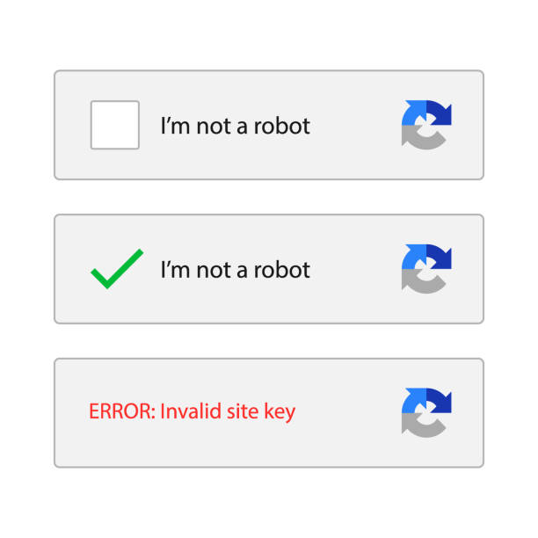
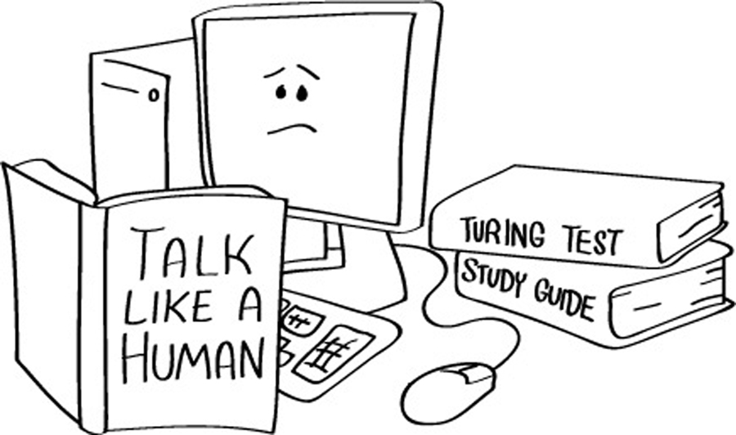
What is artificial intelligence (AI)?
The ultimate goal of artificial intelligence is to build systems able to reach human intelligence levels
ARTIFICIAL INTELLIGENCE DEFINED: FOUR TYPES OF APPROACHES
Thinking humanly: mimicking thought based on the human mind.
Thinking rationally: mimicking thought based on logical reasoning.
Acting humanly: acting in a manner that mimics human behavior.
Acting rationally: acting in a manner that is meant to achieve a particular goal.

Slide 8
Goals of Artificial Intelligence
Replicate human intelligence
Solve Knowledge-intensive tasks
An intelligent connection of perception and action
Building a machine which can perform tasks that requires human intelligence such as:
Proving a theorem
Playing chess
Plan some surgical operation
Driving a car in traffic
Creating some system which can exhibit intelligent behavior, learn new things by itself, demonstrate, explain, and can advise to its user.

Slide 9
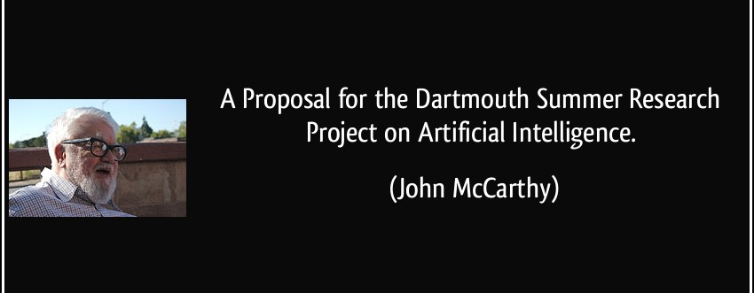
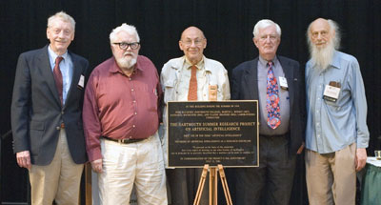
Brief history of AI

Slide 10
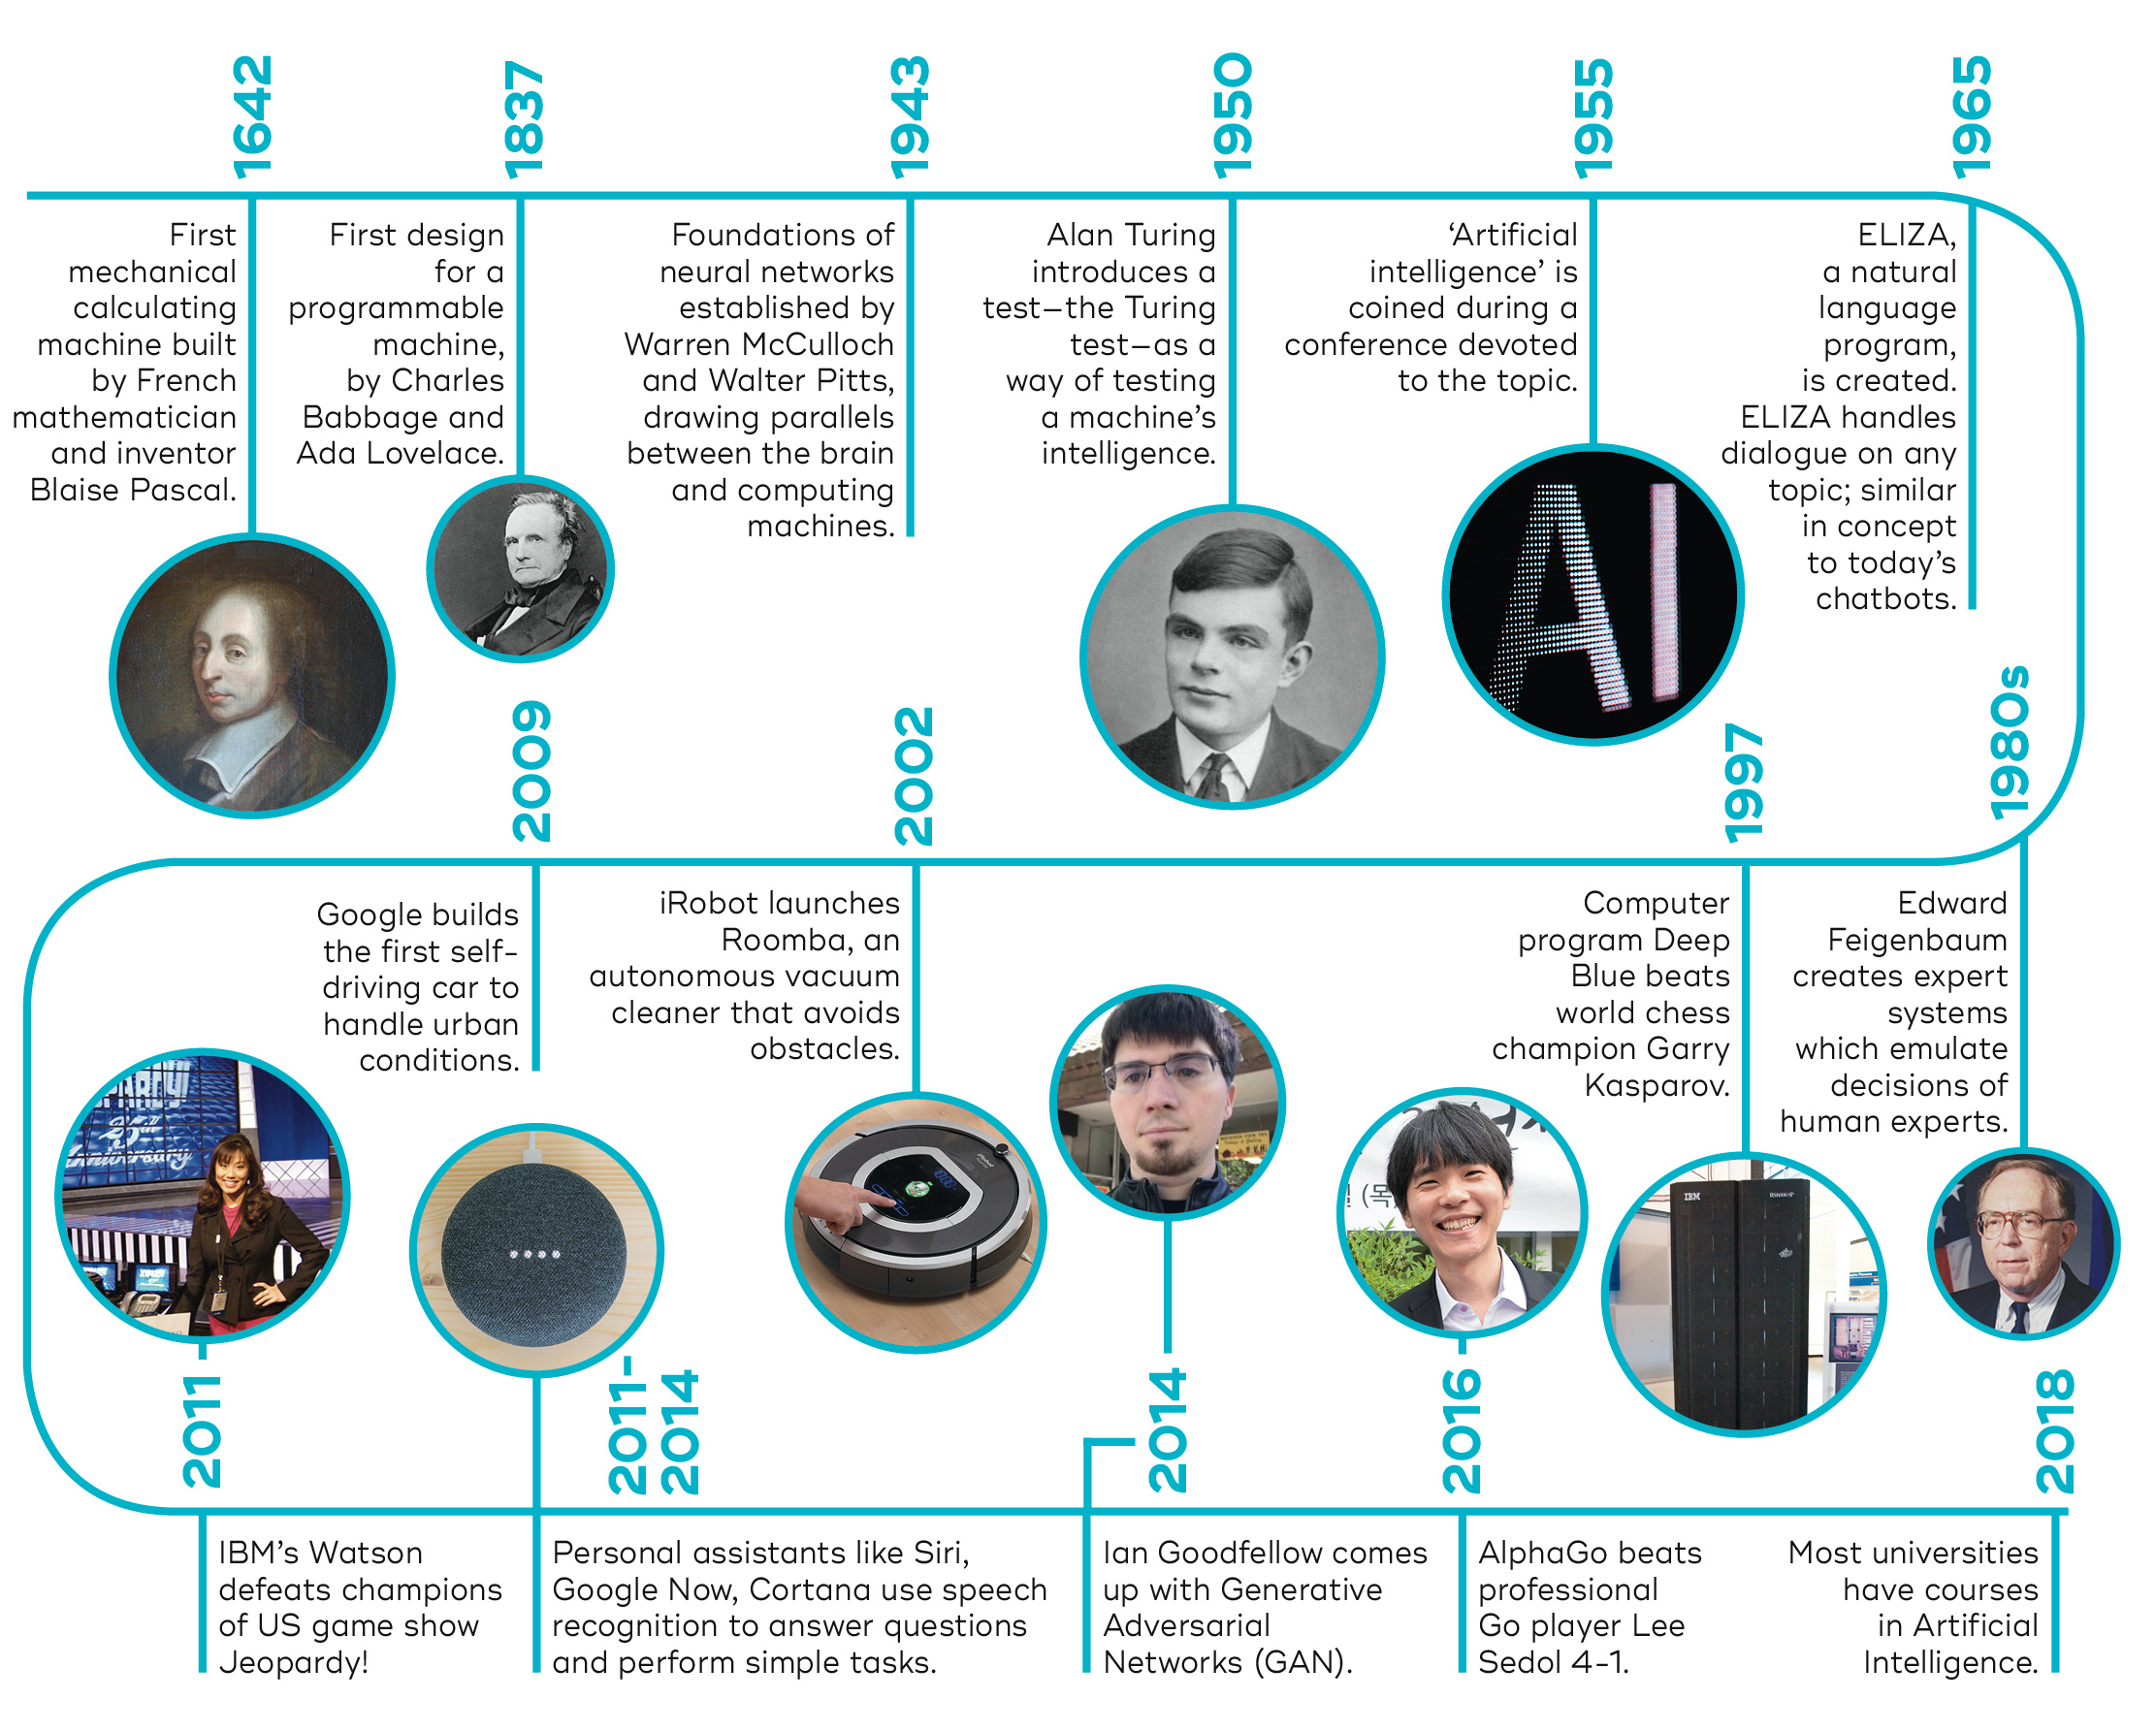
Brief history of AI
https://datalchemy.ai/insights/posts/3-Artificial-Intelligence-Everything-You-Need-to-Know.html

Slide 11
Brief history of AI
1960-1980 The First AI Winter
1970 Expert Systems
1987-1993 The Second AI Winter
1990 Conversation with Computers Becomes a Reality (NLP)
1990 Intelligent Agents
1990 Machine Learning
2011 Digital Virtual Assistants and Chatbots

Slide 12
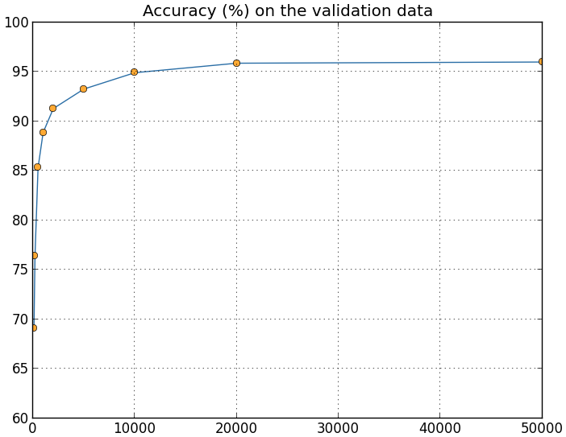
Why are things working today?
More compute power
More data
Better algorithms / models
Accuracy
Amount of Training Data

Slide 13
Advantages of Artificial Intelligence
High Accuracy with less errors
High-Speed
High reliability
Useful for risky areas
Digital Assistant
Useful as a public utility

Slide 14
Disadvantages of Artificial Intelligence
High Cost
Can't think out of the box
No feelings and emotions
Increase dependency on machines
No Original Creativity

Slide 15
Q&A
What is AI?

Slide 16
What is machine learning (ML)?
Machine Learning – is the scientific study of algorithms and statistical models that computer systems use to learn from observations, without being explicitly programmed
In this context, learning refers to:
recognizing complex patterns in data
making intelligent decisions based on data observations

Slide 17
Programming
Traditional Programming
Data
Computer
Output
Program
Machine Learning
Data
Computer
Program
Output
https://www.youtube.com/watch?v=u4nAC8SRdRM&ab_channel=GetYourAIDose

Slide 18
Differences between AI and ML
AI | ML
The art of making machines intelligent is AI. | ML is a part of AI. It is a process of learning from the input data without any help from programming.
AI robots perform tasks to make the system successful rather than training and retraining. | The machines retrain themselves for accuracy and reduction of error.
AI computers are programmed extensively. | ML mechanism does not involve programming, rather it learns from data.

Slide 19
What problems solved with machine learning
Identifying Spam
Making Product Recommendations
Image & Video Recognition
Fraudulent Transactions
Virtual Personal Assistant
Customer Service Automation

Slide 20
When to Use Machine Learning
It is important to remember that ML is not a solution for every type of problem.
There are certain cases where robust solutions can be developed without using ML techniques.
For example, you don not need ML if you can determine a target value by using simple rules, computations, or predetermined steps that can be programmed without needing any data-driven learning.

Slide 21
When to Use Machine Learning
Use machine learning for the following situations:
You cannot code the rules: Many human tasks (such as recognizing whether an email is spam or not spam) cannot be adequately solved using a simple (deterministic), rule-based solution. A large number of factors could influence the answer.
You cannot scale: You might be able to manually recognize a few hundred emails and decide whether they are spam or not.
However, this task becomes tedious for millions of emails. ML solutions are effective at handling large-scale problems.

Slide 22
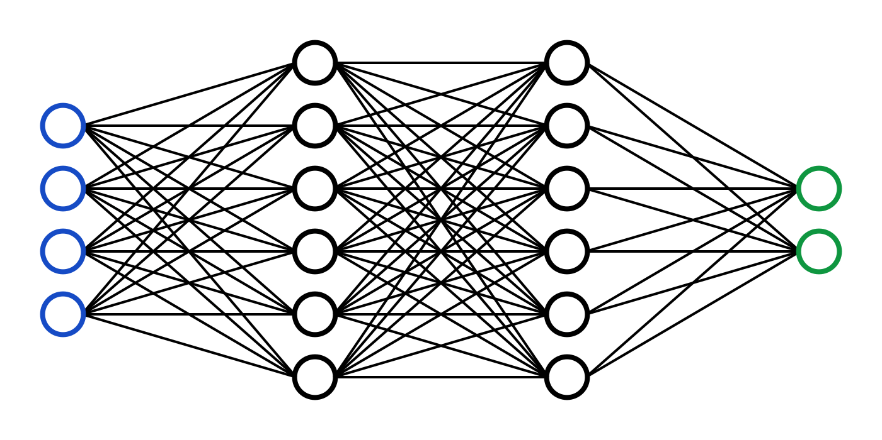
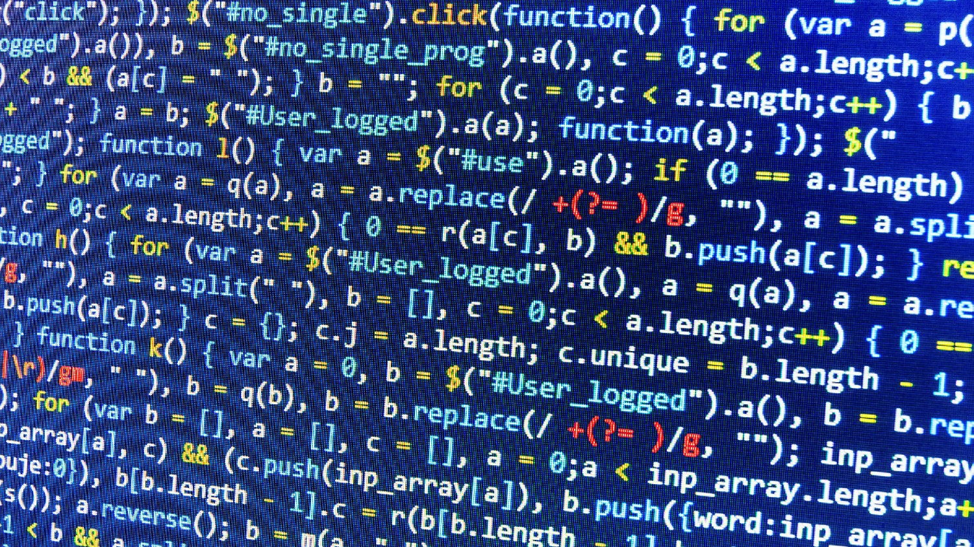
The essence of machine learning
A pattern exists
We cannot express it programmatically
We have data on it

Slide 23
ML representation
Every machine learning algorithm has three components:
Representation / Model Class
Evaluation / Objective Function
Optimization

Slide 24
Where does ML fit in?
Biology
Neuroscience
Applied Math
Machine Learning
Computer Science
Statistics

Slide 25
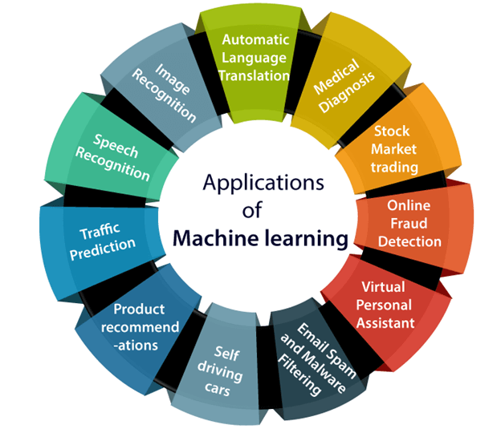
Applications of Machine learning
http://www.test.com/

Slide 26
Q&A
Differences between AI and ML

Slide 27





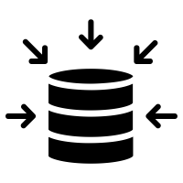

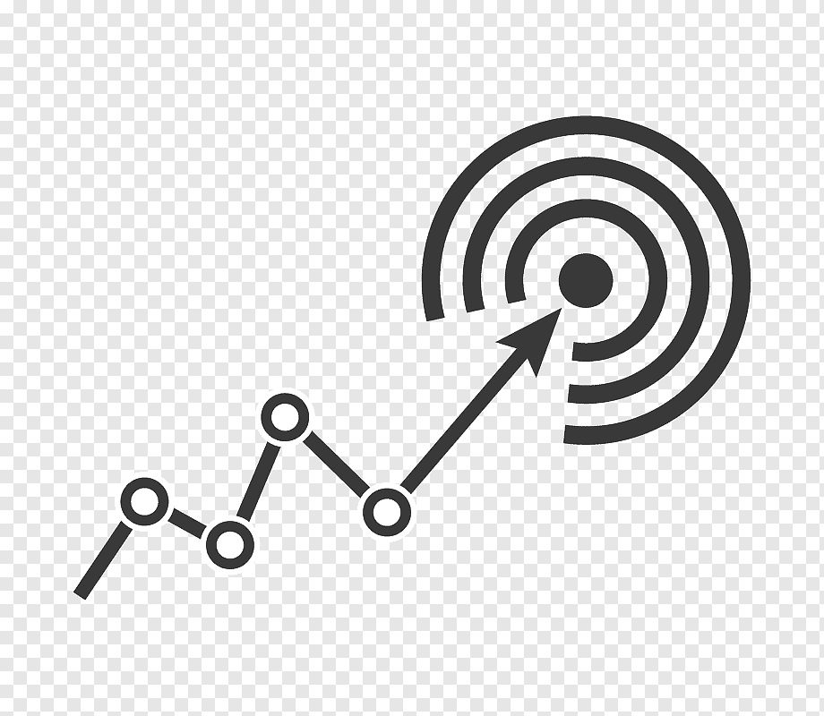
How does Machine Learning works
Training data
Accuracy
Training ML algorithm
Unacceptable
Acceptable
Model input data
Successfully model
New input data
ML algorithm
Prediction

Slide 28
How does Machine Learning works
A Machine Learning system learns from historical data, builds the prediction models, and whenever it receives new data, predicts the output for it.
The accuracy of predicted output depends upon the amount of data, as the huge amount of data helps to build a better model which predicts the output more accurately.
Lear from data
Training
Machine learning algorithm
Building logical models
Output
Input data
New data

Slide 29
How does Machine Learning works
Suppose we have a complex problem, where we need to perform some predictions, so instead of writing a code for it, we just need to feed the data to generic algorithms, and with the help of these algorithms, machine builds the logic as per the data and predict the output.
Machine learning has changed our way of thinking about the problem

Slide 30
Features of Machine Learning
Machine learning uses data to detect various patterns in a given dataset.
It can learn from past data and improve automatically.
It is a data-driven technology.
Machine learning is much similar to data mining as it also deals with the huge amount of the data.

Slide 31
The importance of Machine Learning
Rapid increment in the production of data
Solving complex problems, which are difficult for a human
Decision making in various sector including finance
Finding hidden patterns and extracting useful information from data.
https://www.youtube.com/watch?v=f_uwKZIAeM0&ab_channel=OxfordSparks

Slide 32
Q&A
What is ML?

Slide 33
Q&A
How does Machine Learning works

Slide 34
Q&A
When to Use Machine Learning

Slide 35
Q&A
Main difference between traditional programming and ML programming

Slide 36
Q&A
Why ML is important

Slide 37
Q&A
Where does ML fit in?
https://www.youtube.com/watch?v=Gv9_4yMHFhI&ab_channel=StatQuestwithJoshStarmer

Slide 38
Introduction to Data in Machine Learning
Data is a crucial component in the field of Machine Learning.
It refers to the set of observations or measurements that can be used to train a machine-learning model.
The quality and quantity of data available for training and testing play a significant role in determining the performance of a machine-learning model.
Data can be in various forms such as numerical, categorical, or time-series data, and can come from various sources such as databases, spreadsheets
https://www.youtube.com/watch?v=mYxjl_dkdtM&ab_channel=MMUQ-Step

Slide 39
Introduction to Data in Machine Learning
Machine learning algorithms use data to learn patterns and relationships between input variables and target outputs, which can then be used for prediction or classification tasks.
Data is typically divided into two types:
Labeled data
Unlabeled data

Slide 40
Introduction to Data in Machine Learning
Labeled data includes a label or target variable that the model is trying to predict, whereas unlabeled data does not include a label or target variable.
The data used in machine learning is typically numerical or categorical.
Numerical data includes values that can be ordered and measured, such as age or income.
Categorical data includes values that represent categories, such as gender or type of fruit.

Slide 41
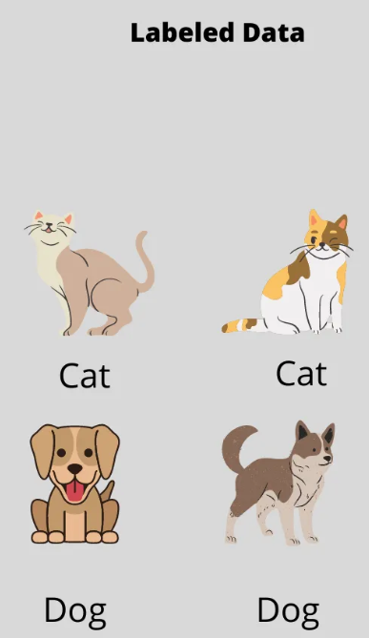
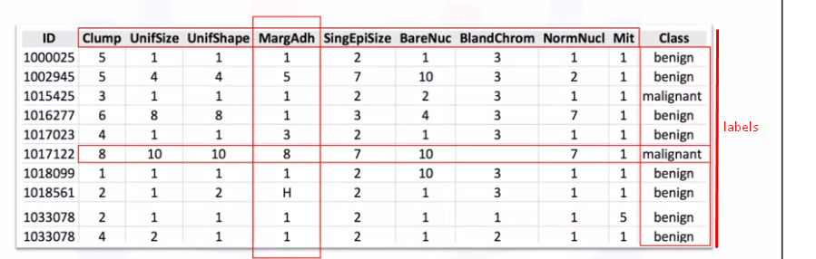
Examples: Labeled dataset
Labeled data, used by Supervised learning add meaningful tags or labels or class to the observations (or rows). These tags can come from observations or asking people or specialists about the data.

Slide 42
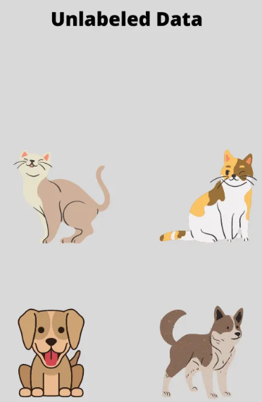
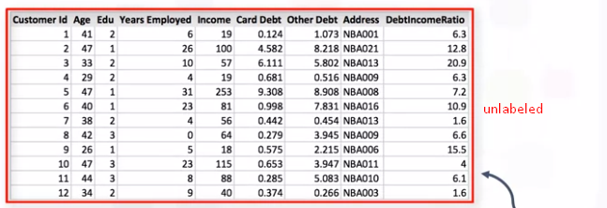
Examples: Unlabeled dataset
Unlabeled data, used by Unsupervised learning however do not have any meaningful tags or labels associated with it.
https://www.youtube.com/watch?v=vSO8dFTtlfE&ab_channel=PK%27s

Slide 43
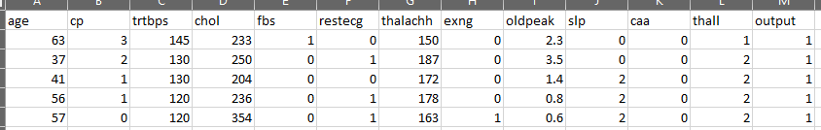
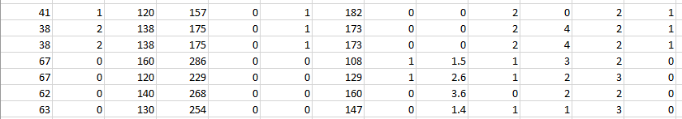
Dataset view
Predicting heart attack probability based on features:
Features: Columns and rows
Label: Output (1: yes, 0: no)

Slide 44
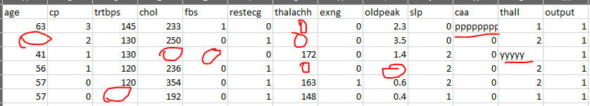
Dataset view
Data preprocessing is an important step in the machine learning pipeline.
This step includes cleaning and normalizing the data, handling missing values, and selecting features or engineering.
https://www.youtube.com/watch?v=P8ERBy91Y90&t=395s

Slide 45
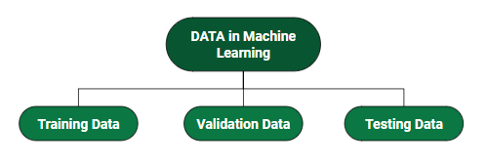
Introduction to Data in Machine Learning
Data can be divided into training and testing sets.
The training set is used to train the model, and the testing set is used to evaluate the model performance. It is important to ensure that the data is split in a random and representative way.
https://www.youtube.com/watch?v=P8ERBy91Y90&ab_channel=AltexSoft

Slide 46
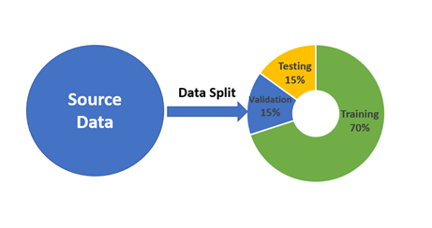
Split data in Machine Learning

Slide 47
Split data in Machine Learning
Training Data: The part of data we use to train our model. This is the data your model sees (input and output) and learns from.
Validation Data: The part of data that is used to do a frequent evaluation of the model, fits on the training dataset along with improving involved hyperparameters (initially set parameters before the model begins learning). This data plays its part when the model is actually training.
Testing Data: Once our model is completely trained, testing data provides an unbiased evaluation. When we feed in the inputs of Testing data, our model will predict some values(without seeing actual output).
https://www.youtube.com/watch?v=dSCFk168vmo&ab_channel=M%C4%B1sraTurp

Slide 48
Different Forms of Data
Numeric Data: If a feature represents a characteristic measured in numbers, it is called a numeric feature.
Categorical Data: A categorical feature is an attribute that can take on one of the limited, and usually fixed number of possible values based on some qualitative property. A categorical feature is also called a nominal feature.
Ordinal Data: This denotes a nominal variable with categories falling in an ordered list. Examples include clothing sizes such as small, medium, and large, or a measurement of customer satisfaction on a scale from “not at all happy” to “very happy”.
https://www.youtube.com/watch?v=DUcXZ08IdMo&ab_channel=365DataScience

Slide 49
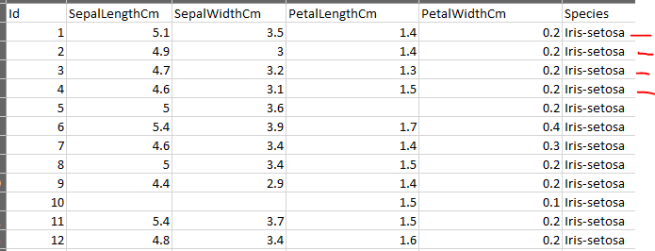
Q&A
It is labeled or unlabeled

Slide 50
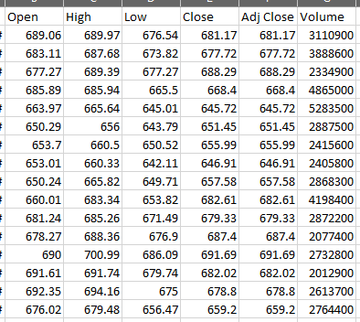
Q&A
It is labeled or unlabeled

Slide 51
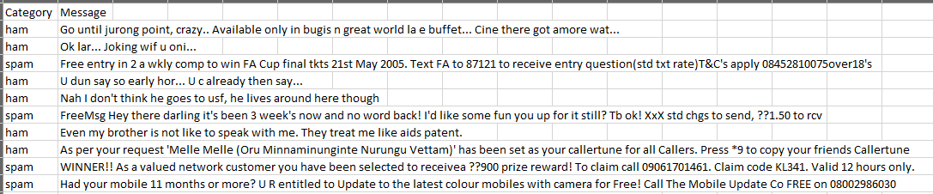
Q&A
It is labeled or unlabeled

Slide 52

ML types
https://www.youtube.com/watch?v=9gGnTQTYNaE&ab_channel=IBMTechnology

Slide 53
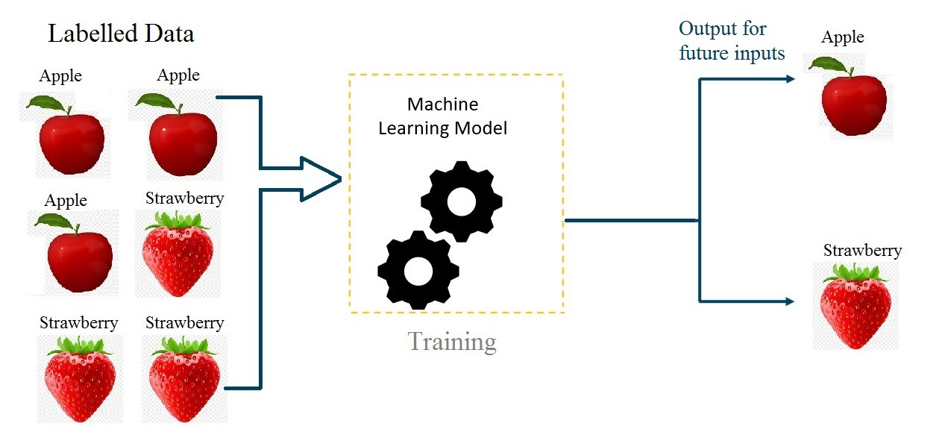
Supervised learning
We have a set of labeled training samples

Slide 54
Supervised learning
Supervised learning uses a training set to teach models to yield the desired output. This training dataset includes inputs and correct outputs, which allow the model to learn over time.
Supervised learning:
· Is simpler and more common than unsupervised learning
· Is used when the human practitioner knows the answer, and wants to train the AI
· Classifies and processes data using machine language
· Uses labeled data (i.e. that which has been classified)

Slide 55
Supervised learning. Types
Supervised learning can be separated into two types of problems when data mining—classification and regression:
Classification uses an algorithm to accurately assign test data into specific categories.
It recognizes specific entities within the dataset and attempts to draw some conclusions on how those entities should be labeled or defined.
Regression is used to understand the relationship between dependent and independent variables.
It is commonly used to make projections, such as for sales revenue for a given business.
https://www.youtube.com/watch?v=9rRLo4nFc3A&ab_channel=Odolution

Slide 56
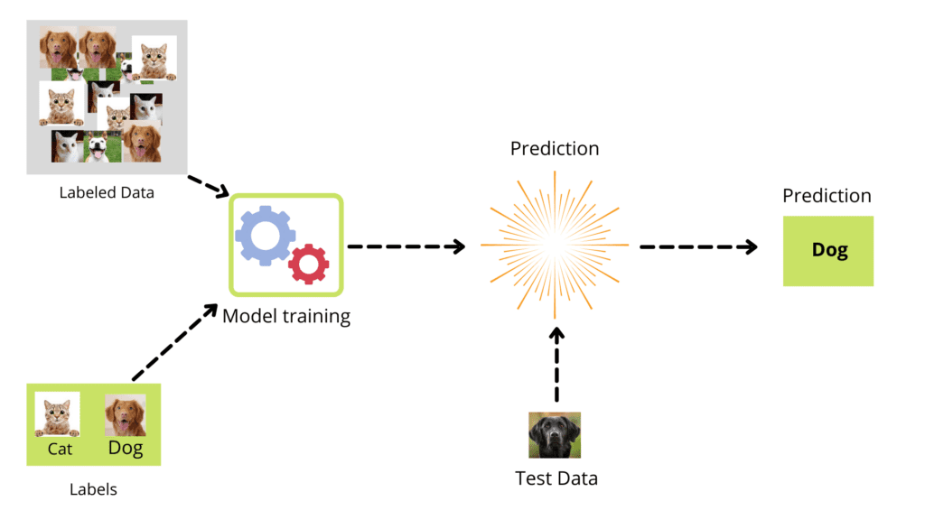
Supervised learning. Training
The training dataset steps:
Get data
Clean, Prepare & Manipulate Data
Train Model
Test Model
Improve

Slide 57
Steps Involved in Supervised Learning
First Determine the type of training dataset
Collect/Gather the labelled training data.
Split the training dataset into training dataset, test dataset, and validation dataset.
Determine the input features of the training dataset, which should have enough knowledge so that the model can accurately predict the output.

Slide 58
Steps Involved in Supervised Learning
Determine the suitable algorithm for the model, such as support vector machine, decision tree, etc.
Execute the algorithm on the training dataset. Sometimes we need validation sets as the control parameters, which are the subset of training datasets.
Evaluate the accuracy of the model by providing the test set.
If the model predicts the correct output, which means our model is accurate.

Slide 59
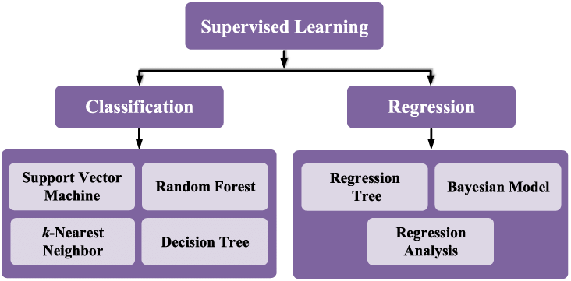
Supervised learning. Algorithms

Slide 60
Supervised learning. Advantages
Supervised learning allows collecting data and produces data output from previous experiences.
Helps to optimize performance criteria with the help of experience.
Supervised machine learning helps to solve various types of real-world computation problems.

Slide 61
Supervised learning. Disadvantages
Classifying big data can be challenging.
Training for supervised learning needs a lot of computation time.
In supervised learning, we need enough knowledge about the classes of object.
Supervised learning cannot predict the correct output if the test data is different from the training dataset.

Slide 62
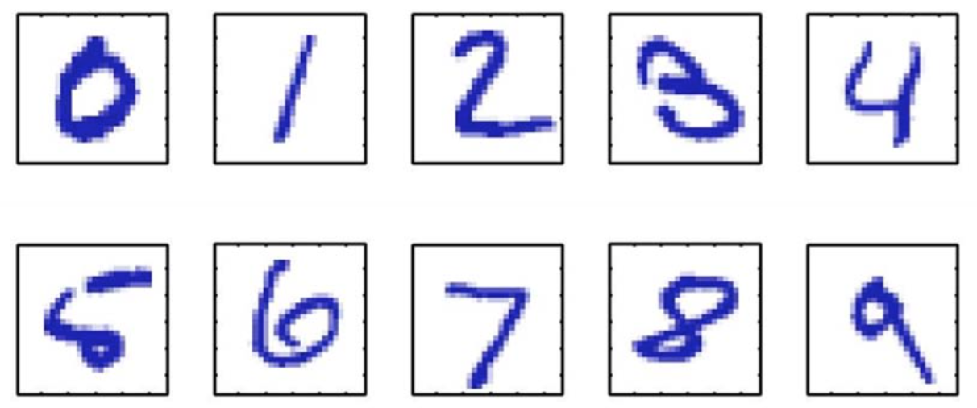
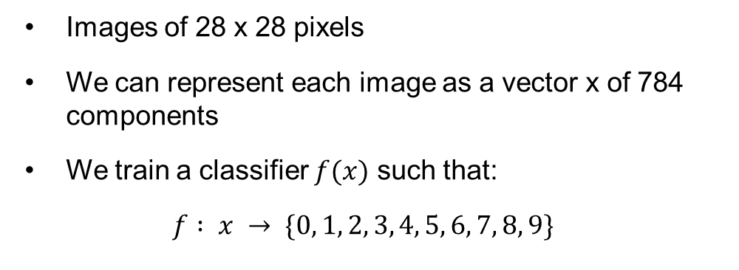
Supervised learning. Example
Handwritten digit recognition (on the MNIST data set)
Images of 28 x 28 pixels
We can represent each image as a vector x of 784 components
We train a classifier $f(x)$ such that:
$$f : x → \{0, 1, 2, 3, 4, 5, 6, 7, 8, 9\}$$

Slide 63
Supervised learning. Example
Handwritten digit recognition (on the MNIST data set)
Starting with a training set of about 60K images (about 6000 images per class)
… the error rate can go down to 0.23% (using convolutional neural networks)
Among the first (learning-based) systems used in a large-scale commercial setting for postal code and bank cheque processing

Slide 64
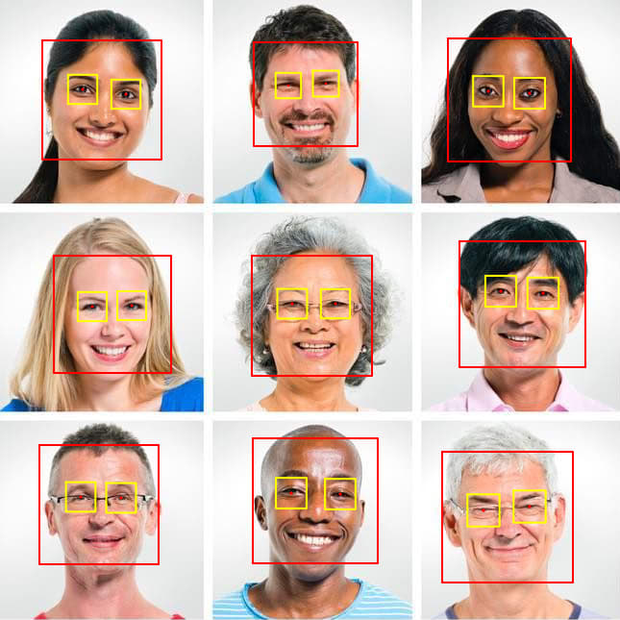
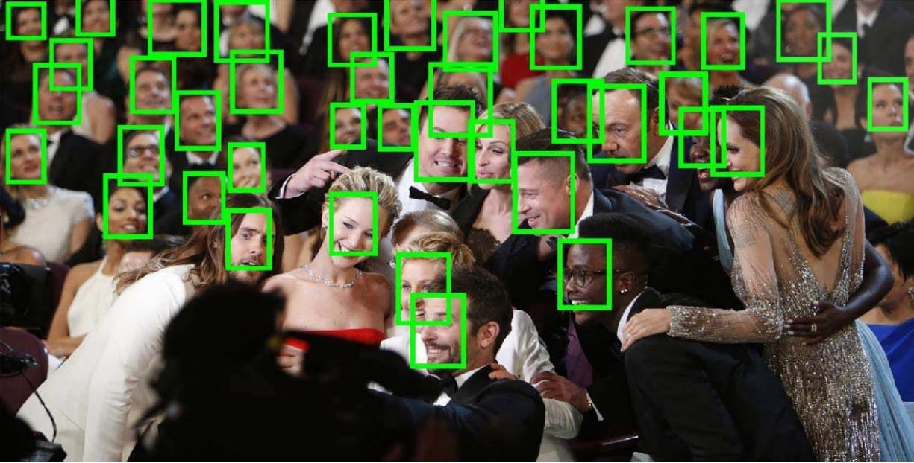
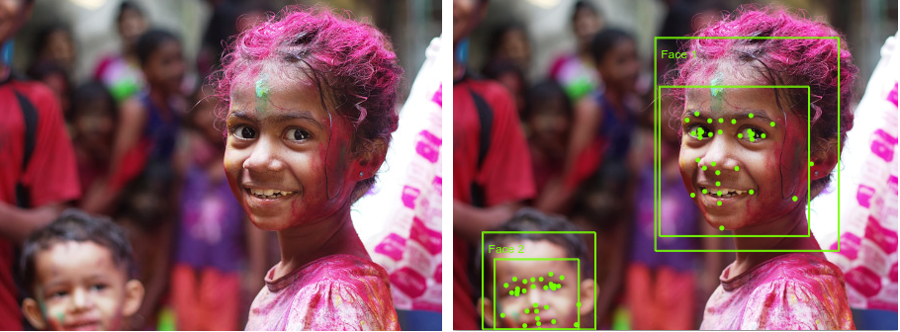
Supervised learning. Example
Face detection
One approach consists of sliding a window over the image
The goal is to classify each window into one of the two possible classes: face or not-face
The original problem is transformed into a classification problem

Slide 65
Limitations
slow (it requires human experts to manually label training examples one by one) and
costly (a model should be trained on the large volumes of hand-labeled data to provide accurate predictions).
https://www.youtube.com/watch?v=Mu3POlNoLdc&ab_channel=AssemblyAI

Slide 66
Q&A
What is Supervised Learning?

Slide 67
Q&A
The types of Supervised Learning

Slide 68
Q&A
Limitations of Supervised Learning

Slide 69
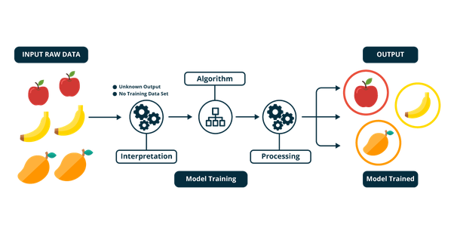
Unsupervised learning
We have a set of unlabeled training samples

Slide 70
Unsupervised learning
Unsupervised learning is a type of machine learning in which models are trained using unlabeled dataset and are allowed to act on that data without any supervision.
Unsupervised machine learning finds all kind of unknown patterns in data.
Unsupervised methods help you to find features which can be useful for categorization.
It is taken place in real time, so all the input data to be analyzed and labeled in the presence of learners.
It is easier to get unlabeled data from a computer than labeled data, which needs manual intervention.

Slide 71
Unsupervised learning. Types
Unsupervised learning can be separated into three:
Association rule mining
Clustering
Recommendation system
Clustering: The clustering technique refers to grouping objects into clusters based on parameters such as similarities or differences between objects. For example, grouping customers by the products they purchase.

Slide 72
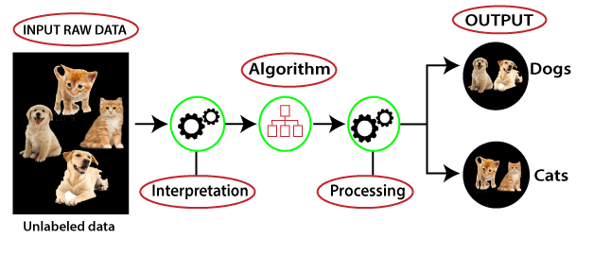
Unsupervised learning. Training
The training dataset steps:
Get data (unlabeled)
Clean, Prepare & Manipulate Data
Train Model
Test Model
Improve

Slide 73
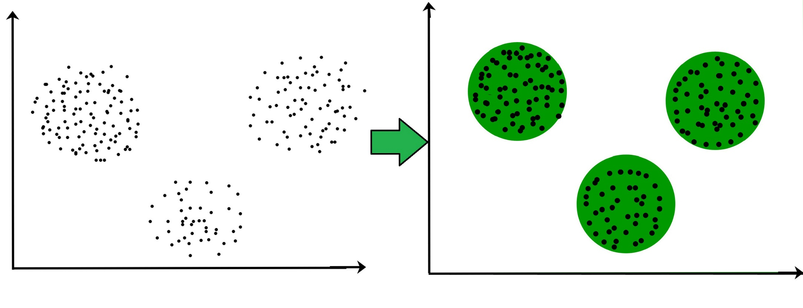
Unsupervised learning. Usage
Explore the structure of the information and detect distinct patterns.
Extract valuable insights.
Implement this into its operation in order to increase the efficiency of the decision-making process.

Slide 74
Applications of Unsupervised Learning
As the world data is increasing tremendously every day, unsupervised learning has many applications.
Grocery shop or e-commerce store/ marketplace:​ Extract Association rules from customers transactional data and recommendations for consumers to buy products.
Social media platform:​ Extract relationships with different users to suggest products or services. Recommend new people for social connect.
Services: ​Recommendations of travel services, a recommendation of houses to rent, or matchmaking services.
Banking:​ Cluster customers based on their financial transactions. Cluster fraudulent transaction for fraud detection.

Slide 75
Applications of Unsupervised Learning
Politics:​ Cluster voter’s opinions about chances of a win for a particular party.
Data visualization: With clustering and ​t-distributed Stochastic Neighbor​ Embedding​ (t-SNE), we can visualize high-dimensional data. Also, this can be used for dimensionality reduction.
Entertainment:​ Recommendations for movies, music, as Netflix and Amazon are doing.
Image segmentation:​ Cluster images portions based on nearest pixel values.
Content:​ personalized newspapers, recommendations of Web pages, e-learning applications, and email filters.
Structural discovery: With clustering, we can discover any hidden structure in the data—cluster twitter data for sentiment analysis.

Slide 76
Advantages of Unsupervised Learning
Unsupervised learning is used for more complex tasks as compared to supervised learning because, in unsupervised learning, we do not have labeled input data.
Unsupervised learning is preferable as it is easy to get unlabeled data in comparison to labeled data.

Slide 77
Disadvantages of Unsupervised Learning
Unsupervised learning is intrinsically more difficult than supervised learning as it does not have corresponding output.
The result of the unsupervised learning algorithm might be less accurate as input data is not labeled, and algorithms do not know the exact output in advance.

Slide 78


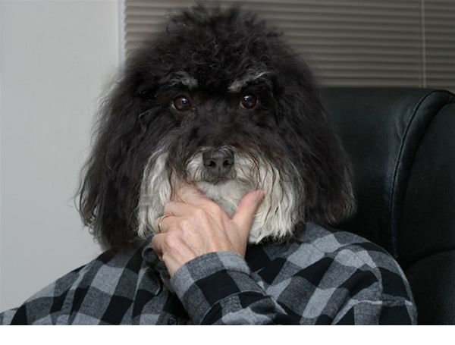
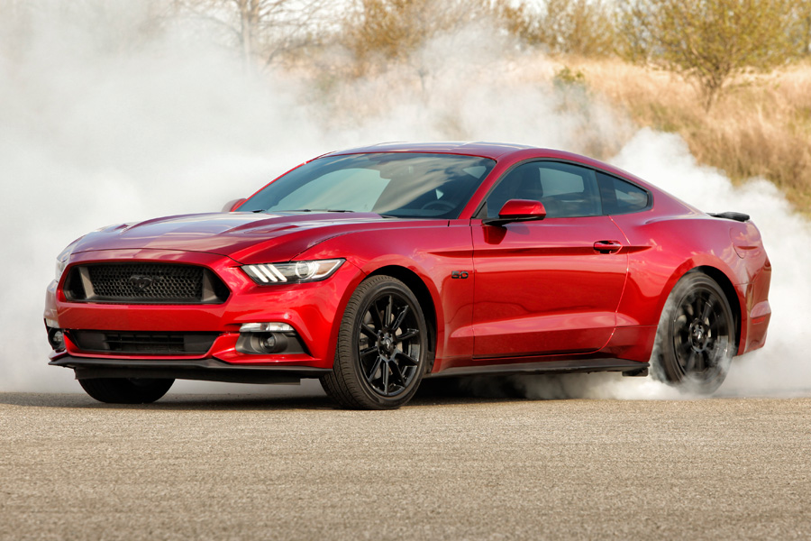
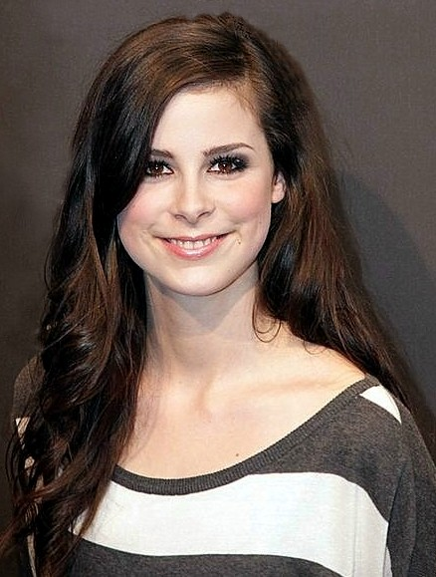
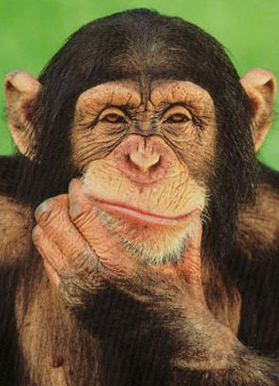
Unsupervised Learning. Example
We have an unlabeled training set of samples
Example 1: clustering images based on similarity

Slide 79
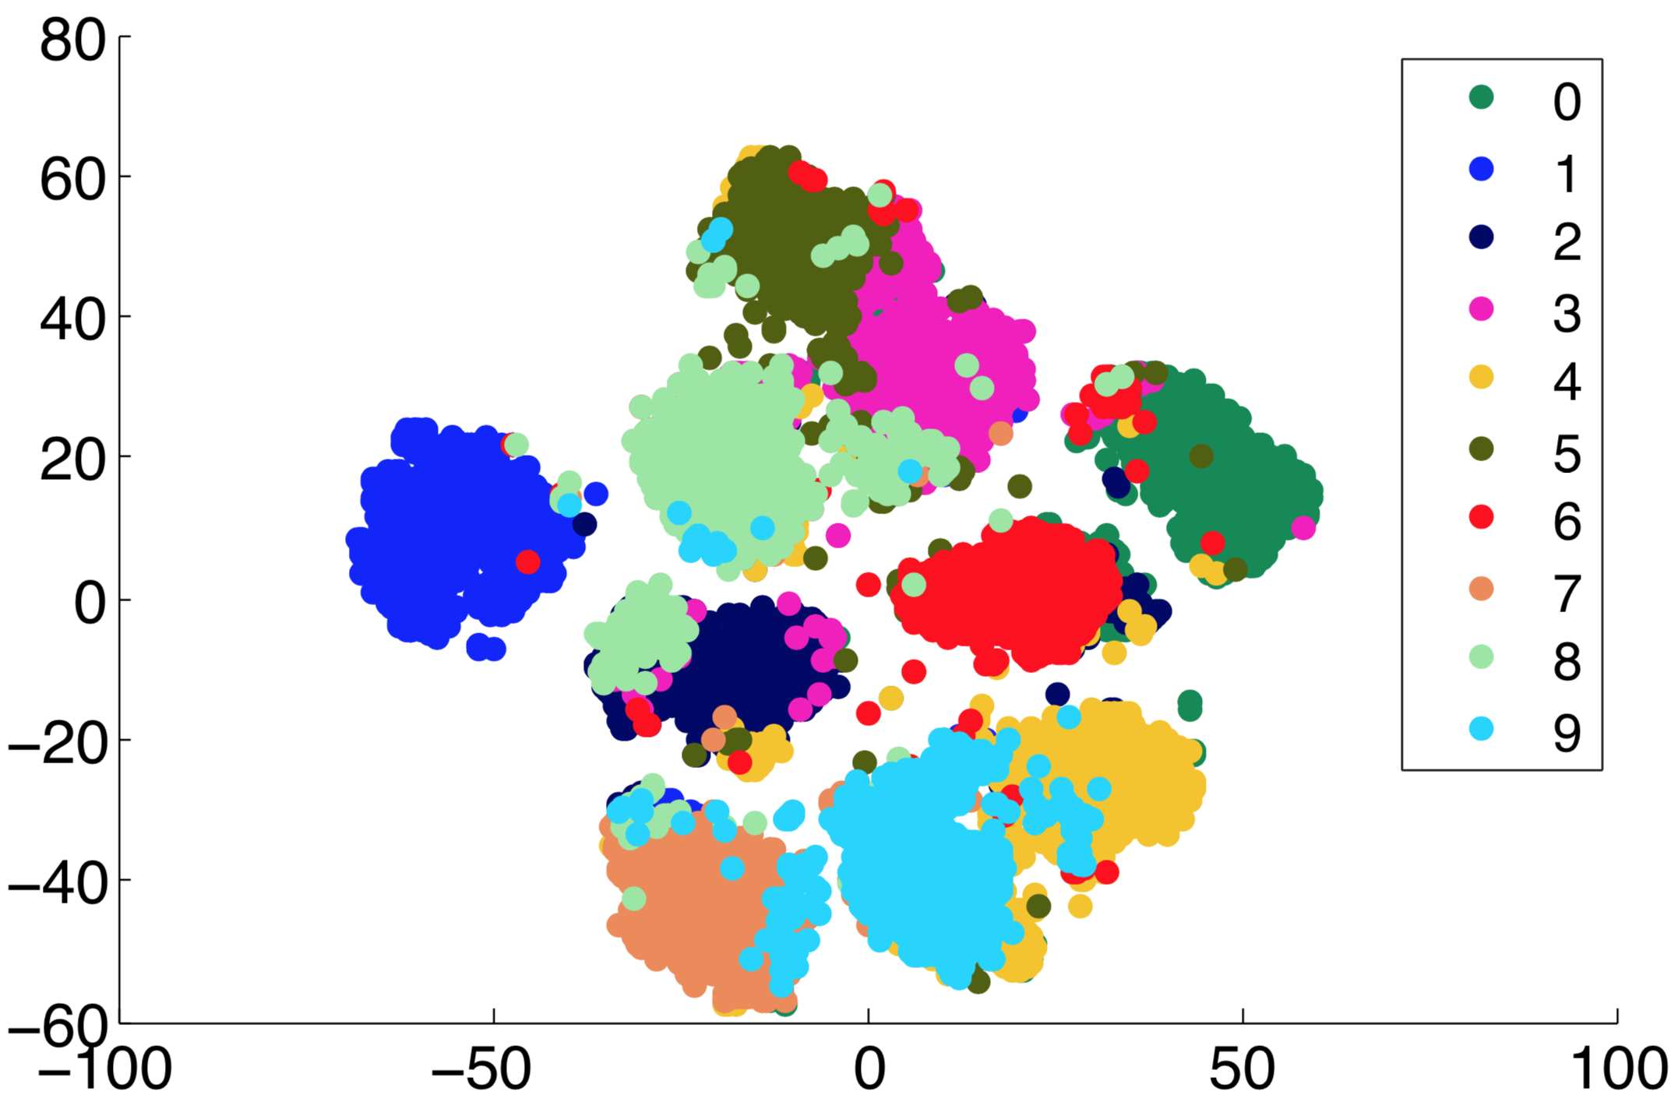
Unsupervised Learning. Example
Clustering MNIST images based on similarity

Slide 80
Unsupervised learning
Example 2: unsupervised features learning

Slide 81
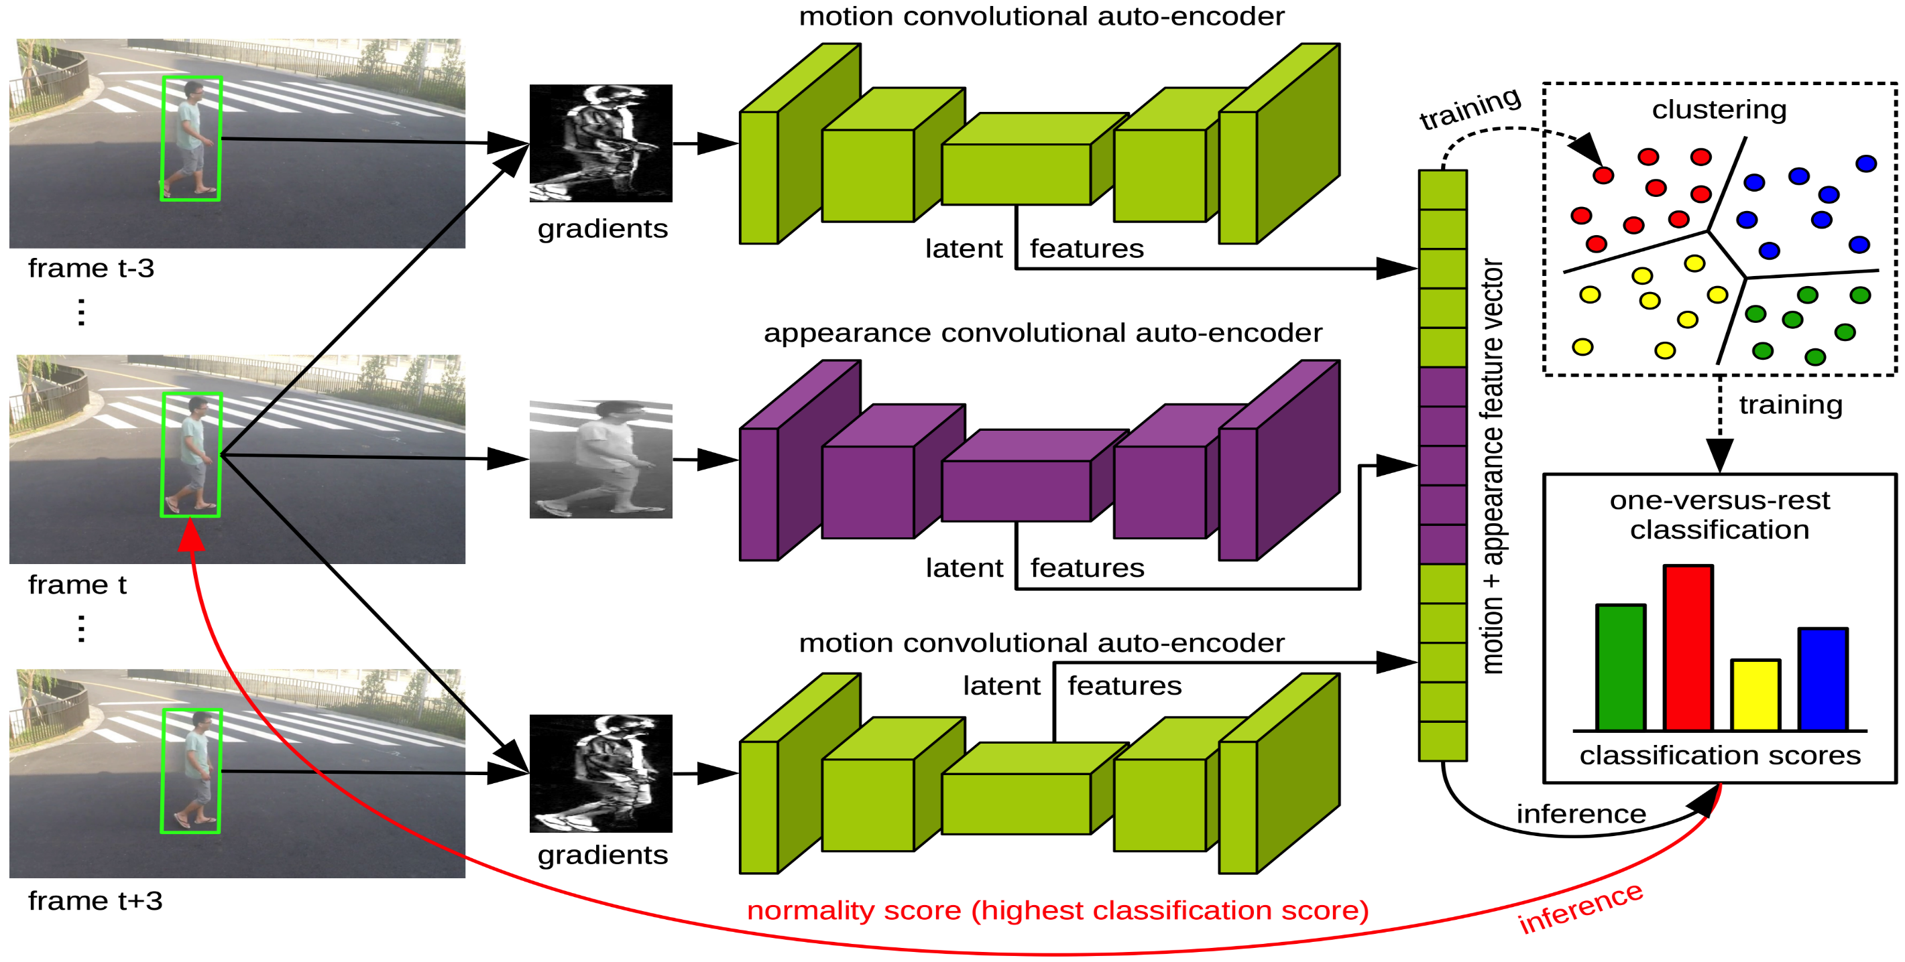
Unsupervised learning
Example 2: unsupervised features learning for abnormal event detection [Ionescu et al. CVPR2019]

Slide 82
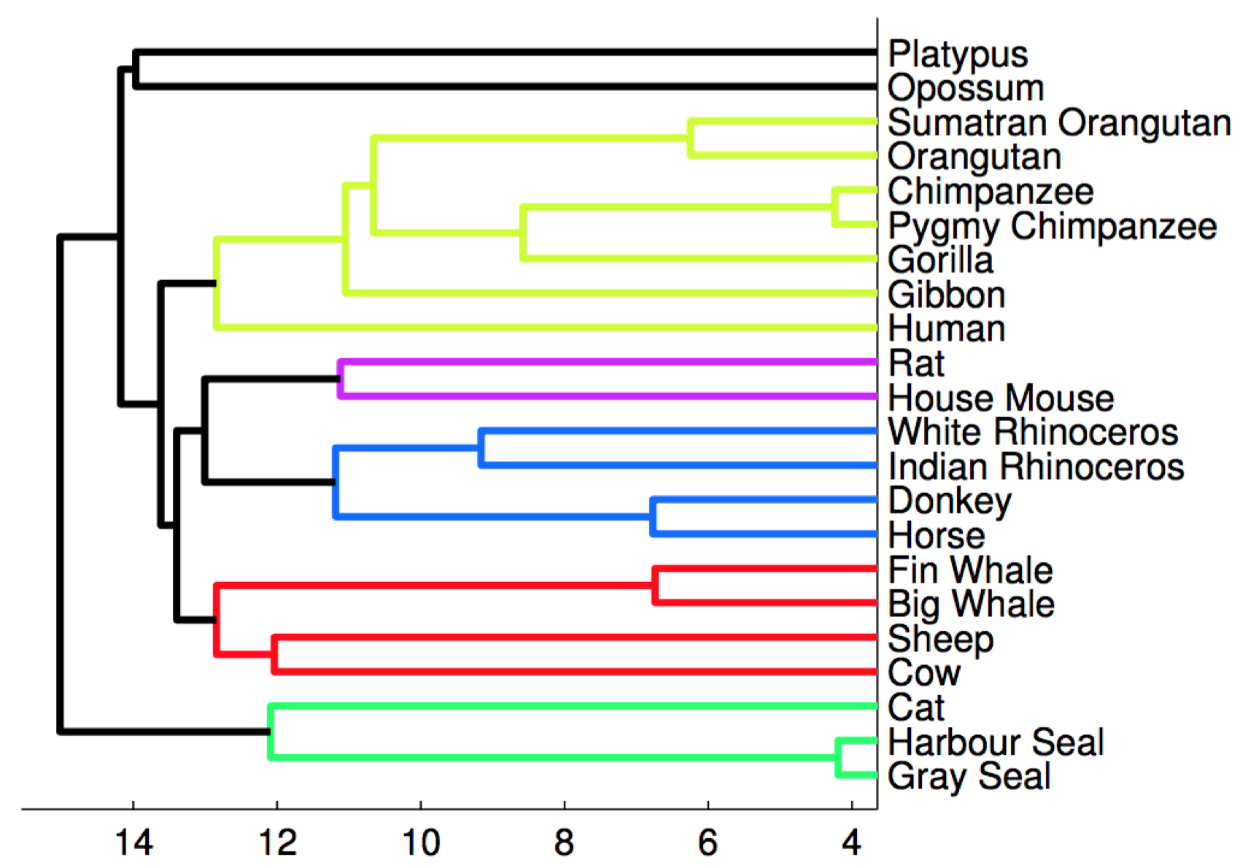
Unsupervised learning
Example 3: clustering mammals by family, species, etc.
The task is to generate the phylogenetic tree based on DNA

Slide 83
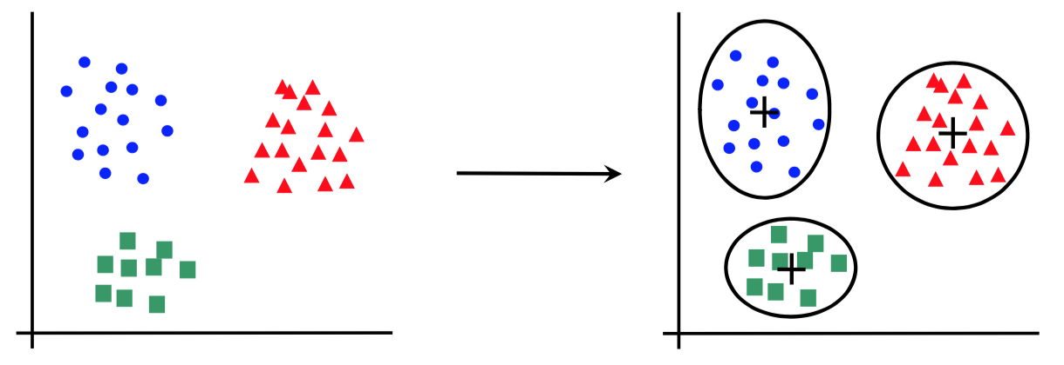
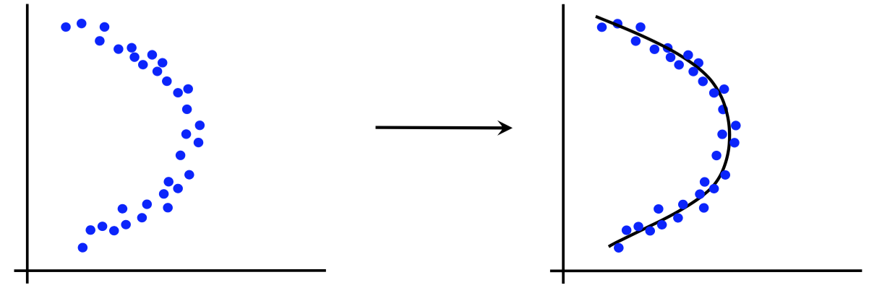
Canonical forms of unsupervised learning problems
Clustering
Dimensionality Reduction

Slide 84
Unsupervised learning models
K-means clustering
DBScan
Hierarchical clustering
Principal Component Analysis
t-Distributed Stochastic Neighbor Embedding
Hidden Markov Models
Many others…

Slide 85
Limitations
has a limited area of applications (mostly for clustering purposes)
provides less accurate results.
https://www.youtube.com/watch?v=yteYU_QpUxs&ab_channel=AssemblyAI

Slide 86
Q&A
What is Unsupervised Learning?

Slide 87
Q&A
The types of Unsupervised Learning

Slide 88
Q&A
Limitations of Unsupervised Learning

Slide 89
Differences between supervised and unsupervised
Supervised Learning | Unsupervised Learning
Supervised learning algorithms are trained using labeled data. | Unsupervised learning algorithms are trained using unlabeled data.
Supervised learning model takes direct feedback to check if it is predicting correct output or not. | Unsupervised learning model does not take any feedback.
Supervised learning model predicts the output. | Unsupervised learning model finds the hidden patterns in data.
In supervised learning, input data is provided to the model along with the output. | In unsupervised learning, only input data is provided to the model.
The goal of supervised learning is to train the model so that it can predict the output when it is given new data. | The goal of unsupervised learning is to find the hidden patterns and useful insights from the unknown dataset.

Slide 90
Differences between supervised and unsupervised
Supervised Learning | Unsupervised Learning
Supervised learning needs supervision to train the model. | Unsupervised learning does not need any supervision to train the model.
Supervised learning can be categorized in Classification and Regression problems. | Unsupervised Learning can be classified in Clustering and Associations problems.
Supervised learning can be used for those cases where we know the input as well as corresponding outputs. | Unsupervised learning can be used for those cases where we have only input data and no corresponding output data.
Supervised learning model produces an accurate result. | Unsupervised learning model may give less accurate result as compared to supervised learning.
https://www.youtube.com/watch?v=W01tIRP_Rqs&ab_channel=IBMTechnology

Slide 91
Semi-supervised learning
Training dataset
All data is labeled
Model
Supervised learning
All data is unlabeled
Model
Unsupervised learning
Small portion of data is labeled
?
Model
Lots of data is unlabeled

Slide 92
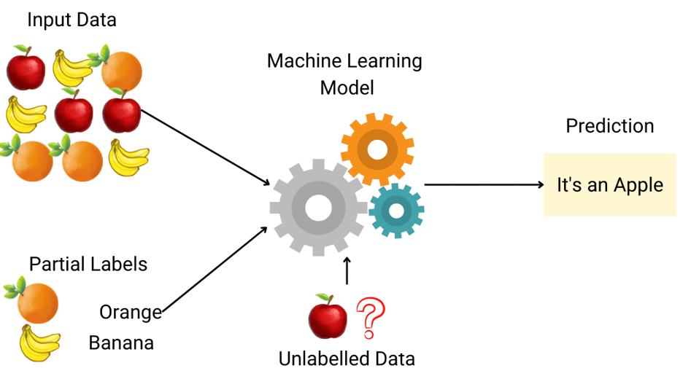

Semi-supervised learning
Semi-Supervised learning is a type of Machine Learning algorithm that represents the intermediate ground between Supervised and Unsupervised learning algorithms. It uses the combination of labeled and unlabeled datasets during the training period.

Slide 93
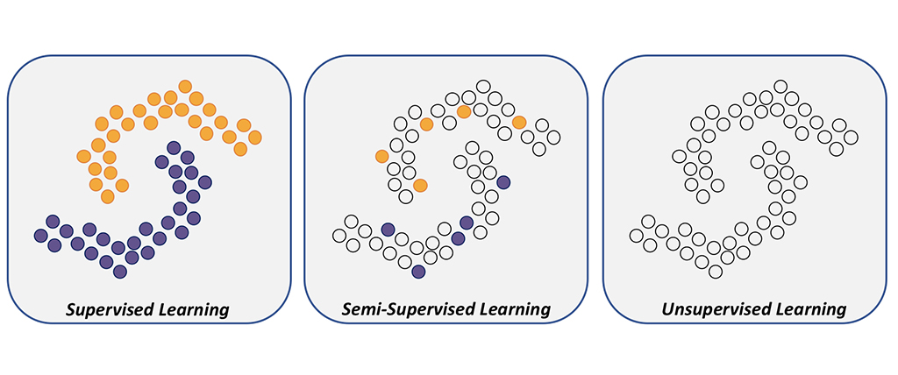
Semi-supervised learning

Slide 94
Semi-supervised learning self- training method. Step 1
A small portion of data with human – made labels
First classifier
Pick a small amount of labeled data, e.g., images showing cats and dogs with their respective tags, and use dataset to train a base model with the help of ordinary supervised methods

Slide 95
Semi-supervised learning self- training method. Step 2
A lots of unlabeled data
First classifier trained on labeled data
Pseudo - labels
Then applied the process known as pseudo-labeling — when take the partially trained model and use it to make predictions for the rest of the database which is yet unlabeled. The labels generated thereafter are called pseudo as they are produced based on the originally labeled data that has limitations.

Slide 96
Semi-supervised learning self- training method. Step 3
Original labeled data
New data
Improved classifier trained on new dataset
Predictions
Most confident pseudo-labels
From this point, the most confident predictions made with model (for example, if the confidence of over 80 percent that a certain image shows a cat, not a dog). If any of the pseudo-labels exceed this confidence level, will be added into the labeled dataset and create a new, combined input to train an improved model.

Slide 97
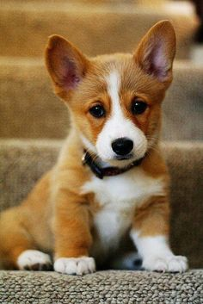
Semi-supervised learning. Example
Example 1: object recognition in images, some of which are annotated with corresponding class labels
Car
Dog
Person

Slide 98
Q&A
What is Semi-Supervised Learning?

Slide 99
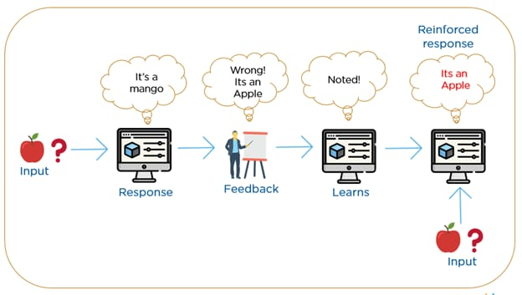
Reinforcement learning
Reinforcement Learning is a feedback-based Machine learning technique in which an agent learns to behave in an environment by performing the actions and seeing the results of actions. For each good action, the agent gets positive feedback, and for each bad action, the agent gets negative feedback or penalty.

Slide 100
Reinforcement learning
In Reinforcement Learning, the agent learns automatically using feedbacks without any labeled data, unlike supervised learning.
Since there is no labeled data, so the agent is bound to learn by its experience only.
RL solves a specific type of problem where decision making is sequential, and the goal is long-term, such as game-playing, robotics, etc.
The agent interacts with the environment and explores it by itself. The primary goal of an agent in reinforcement learning is to improve the performance by getting the maximum positive rewards.

Slide 101
Reinforcement learning
The agent learns with the process of hit and trial, and based on the experience, it learns to perform the task in a better way.
Hence, we can say that "Reinforcement learning is a type of machine learning method where an intelligent agent (computer program) interacts with the environment and learns to act within that." How a Robotic dog learns the movement of his arms is an example of Reinforcement learning.
It is a core part of Artificial intelligence, and all AI agent works on the concept of reinforcement learning. Here we do not need to pre-program the agent, as it learns from its own experience without any human intervention.

Slide 102
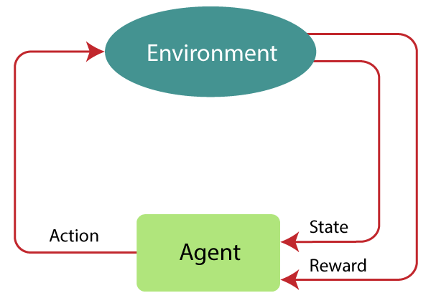
Reinforcement learning. Working steps
The agent continues doing these three things (take action, change state/remain in the same state, and get feedback), and by doing these actions, he learns and explores the environment.
The agent learns that what actions lead to positive feedback or rewards and what actions lead to negative feedback penalty. As a positive reward, the agent gets a positive point, and as a penalty, it gets a negative point.

Slide 103


Reinforcement learning. Example
Case # 1: There is a baby in the family, and she has just started walking, and everyone is quite happy about it. So one day, the parents try to set a goal, let us baby reach the couch, and see if the baby is able to do so.
Result of Case 1: The baby successfully reaches the settee, and thus everyone in the family is very happy to see this. The chosen path now comes with a positive reward.
Points: Reward + (+n) → Positive reward.

Slide 104
Reinforcement learning. Example
Case # 2: The baby was not able to reach the couch, and the baby has fallen. It hurts! What possibly could be the reason? There might be some obstacles in the path to the couch, and the baby had fallen to obstacles.
Result of Case 2: The baby falls to some obstacles, and she cries! Oh, that was bad, she learned, not to fall into the trap of obstacle the next time. The chosen path now comes with a negative reward.
Points: Rewards + (-n) →Negative reward.

Slide 105
Q&A
What are the different types of Machine Learning Algorithms?

Slide 106
Q&A
What is Reinforcement learning?

Slide 107
Q&A
What is the main difference between supervised and unsupervised learning?

Slide 108
Questions: sabinatuit@gachon.ac.kr

